Slide 1
Unit – II
Magnetic Circuits and Magnetic Materials

Slide 2
Magnetic Circuit
Electromagnetic system is an important element of all rotating electric machinery and static devices like transformer.
Role is to create & control electromagnetic fields for EMEC process.
EMEC happens with the help of magnetic field as a coupling medium.
The closed path followed by the magnetic flux is called a magnetic circuit.
Made up of materials having high permeability such as iron, soft steel etc.

Slide 3
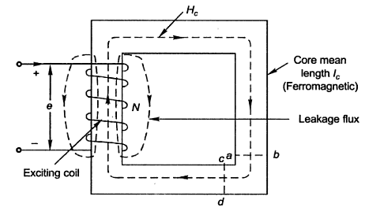
Magnetic Circuit
Electromagnetic system
Ferromagnetic core
Exciting coil
Coil has N turns
Coil carries a current of I amps
Magnetic field established
Magnetic flux flows through the core
Small flux leaks through air

Slide 4
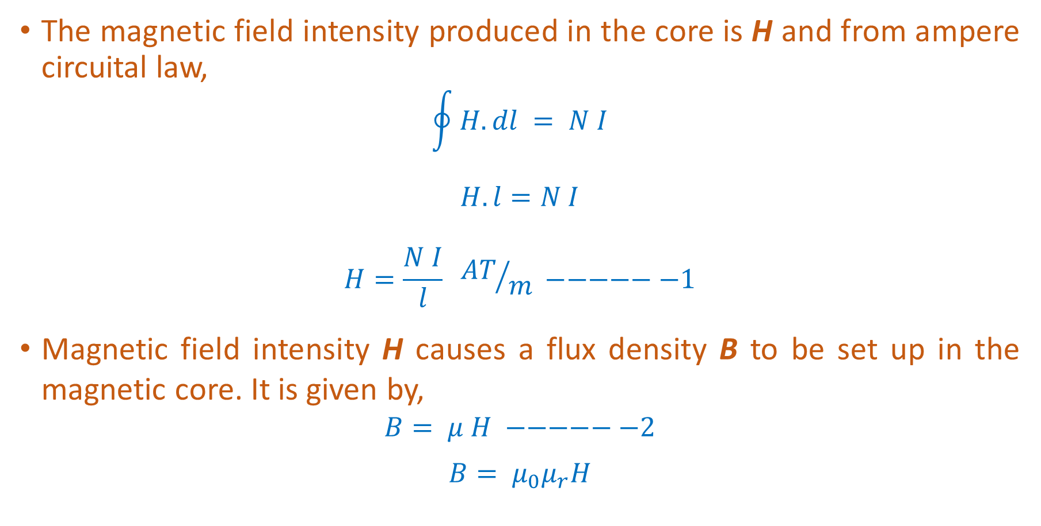
Magnetic Circuit
The magnetic field intensity produced in the core is H and from ampere circuital law,
$$\oint{H. dl} = N I$$
$$H.l=N I$$
$$H=\frac{N I}{l} {AT}/m −−−−−−1$$
Magnetic field intensity H causes a flux density B to be set up in the magnetic core. It is given by,
$$B= μ H −−−−−−2$$
$B= μ_{0}μ_{r}H$

Slide 5
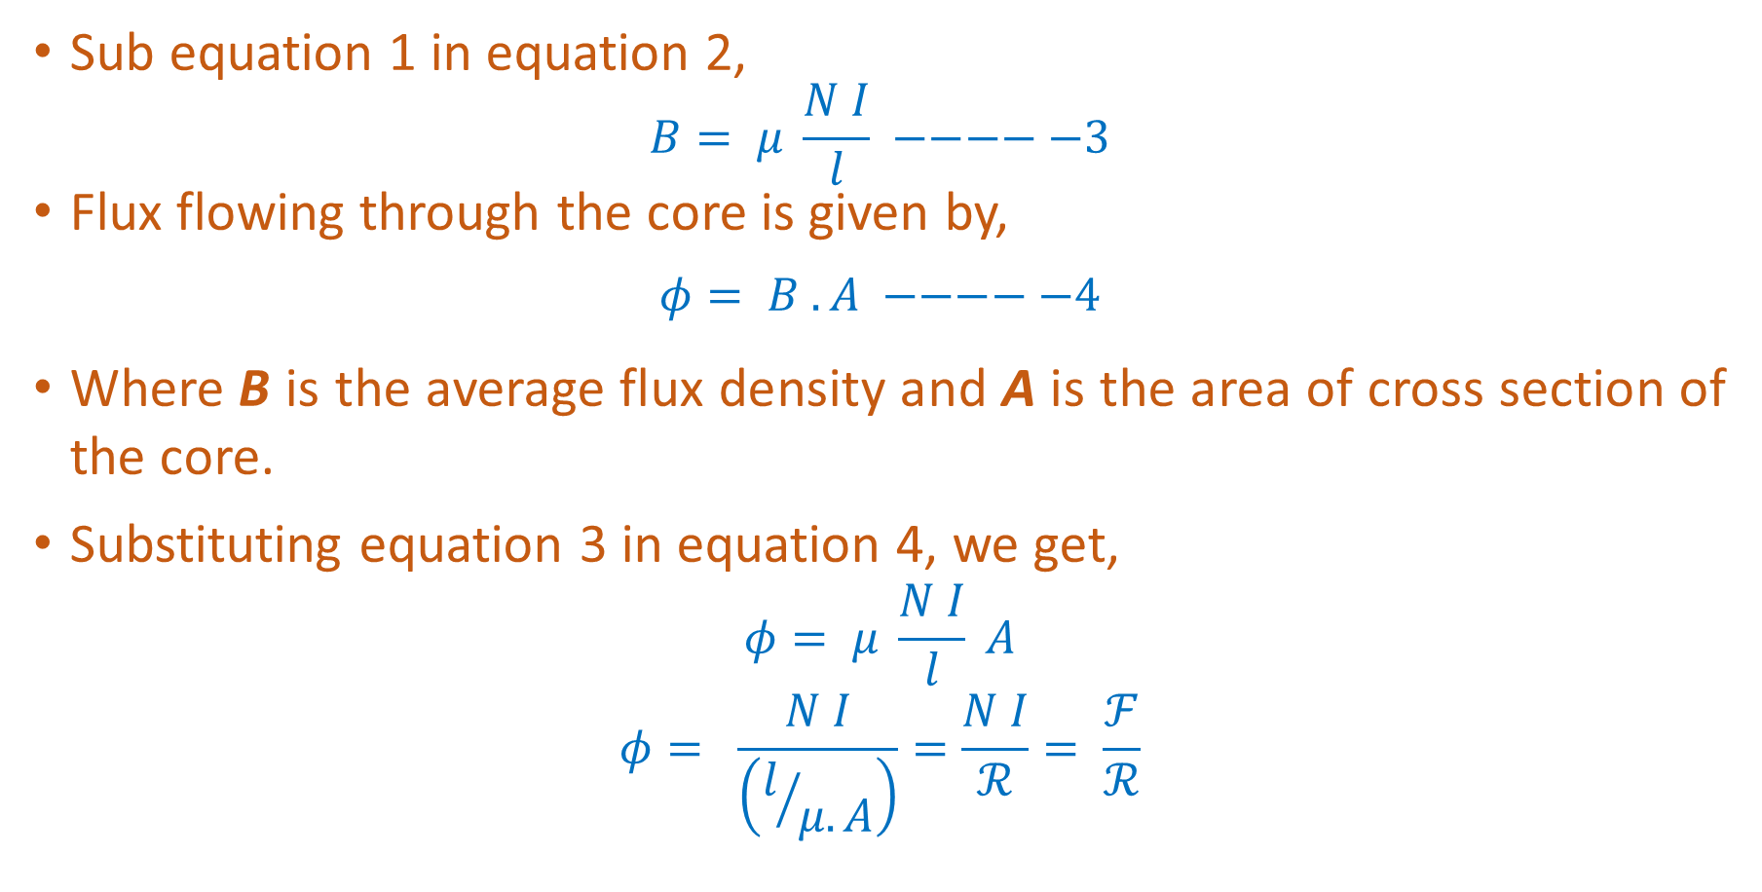
Magnetic Circuit
Sub equation 1 in equation 2,
$$B= μ \frac{N I}{l} −−−−−3$$
Flux flowing through the core is given by,
$$φ= B .A −−−−−4$$
Where B is the average flux density and A is the area of cross section of the core.
Substituting equation 3 in equation 4, we get,
$$φ= μ \frac{N I}{l} A$$
$$φ= \frac{N I}{\left(l/{μ.A}\right)}=\frac{N I}{ℛ}= \frac{ℱ}{ℛ}$$

Slide 6
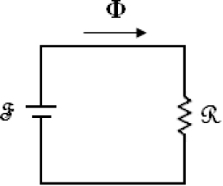
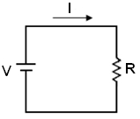
Magnetic Circuit and Electric Circuit

Slide 7
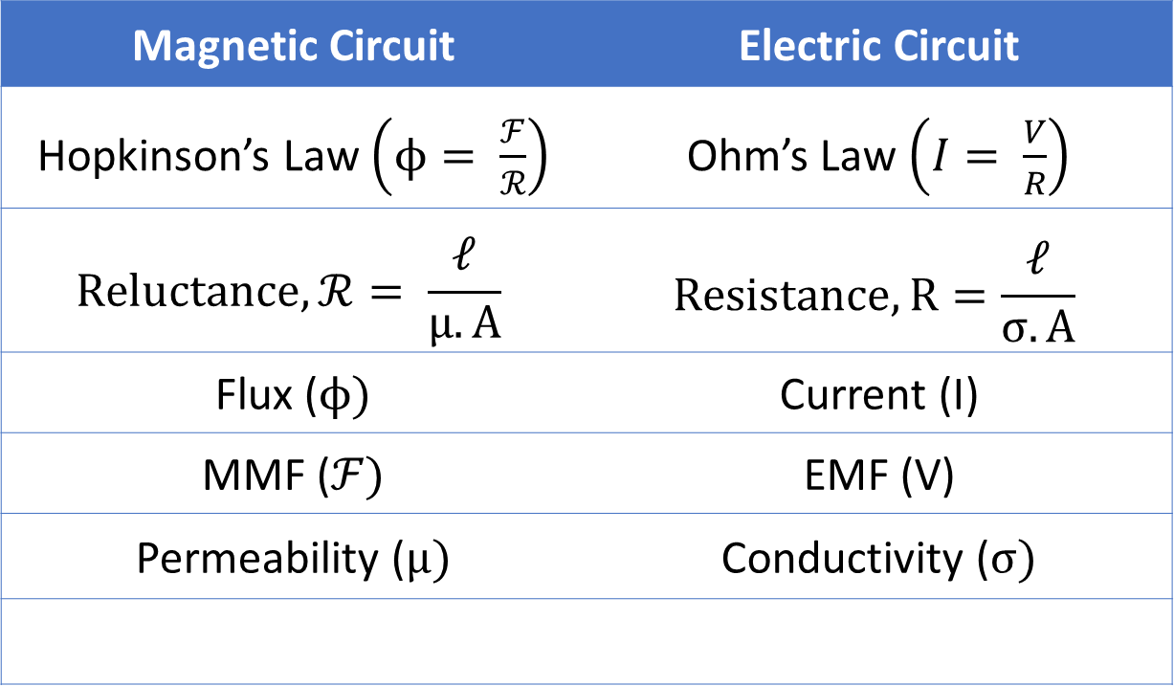
Comparison of Magnetic and Electric Circuits
Magnetic Circuit | Electric Circuit
Hopkinson’s Law $\left(ϕ= \frac{ℱ}{ℛ}\right)$ | Ohm’s Law $\left(I= \frac{V}{R}\right)$
$$Reluctance, ℛ= \frac{𝓁}{μ.Α}$$ | $$Resistance, R=\frac{𝓁}{σ.A}$$
Flux ($ϕ)$ | Current (I)
MMF ($ℱ)$ | EMF (V)
Permeability ($μ)$ | Conductivity ($σ)$

Slide 8
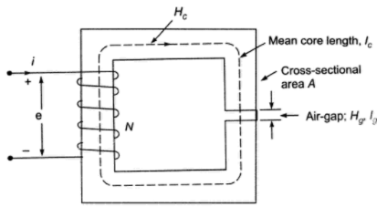
The magnetic circuit has dimensions: A_{C} = 4 X 4 cm², l_{g} = 0.06 cm, l_{c} = 40 cm and N = 600 turns. Assume the value of µ_{r} = 6000 for iron. Find the exciting current for B_{C} = 1.2 T and the corresponding flux and flux linkages.

Slide 9






Solution

Slide 10
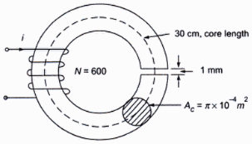
A wrought iron bar 30 cm long and 2 cm in diameter is bent into a circular shape as shown in figure below. It is then wound with 600 turns of wire. Calculate the current required to produce a flux of 0.5 mWb in the magnetic circuit in the following cases:
(i) no air – gap
(ii) with an air-gap of 1 mm
(µ_{r} of iron = 4000)

Slide 11

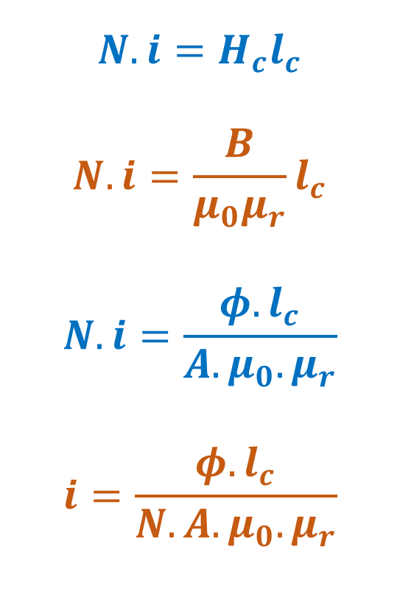

(i) No Air-Gap
$$N.i=H_{c}l_{c}$$
$$N.i=\frac{B}{μ_{0}μ_{r}}l_{c}$$
$$N.i=\frac{φ.l_{c}}{{A.μ}_{0}.μ_{r}}$$
$$i=\frac{φ.l_{c}}{N.{A.μ}_{0}.μ_{r}}$$
$$i=\frac{0.5×{10}^{−3}×30×{10}^{−2}}{600.π.{\left(1×{10}^{−2}\right)}^{2}\left(4π×{10}^{−7}\right)×4000}$$
$$i=0.158 A$$

Slide 12

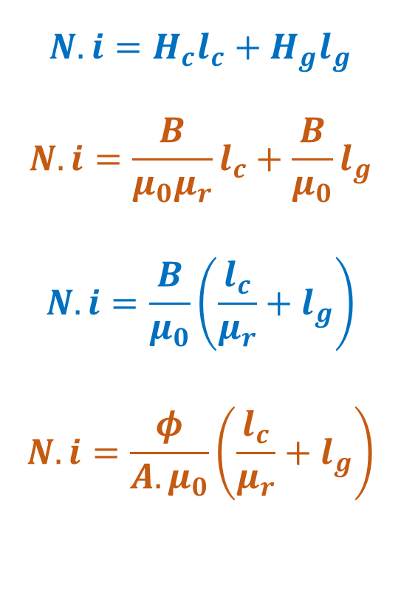

(ii) With Air-Gap
$$N.i=H_{c}l_{c}+H_{g}l_{g}$$
$$N.i=\frac{B}{μ_{0}μ_{r}}l_{c}+\frac{B}{μ_{0}}l_{g}$$
$$N.i=\frac{B}{μ_{0}}\left(\frac{l_{c}}{μ_{r}}+l_{g}\right)$$
$$N.i=\frac{φ}{{A.μ}_{0}}\left(\frac{l_{c}}{μ_{r}}+l_{g}\right)$$
$$i=\frac{φ}{N.{A.μ}_{0}}\left(\frac{l_{c}}{μ_{r}}+l_{g}\right)$$
$$i=\frac{0.5×{10}^{−3}}{600.π.{\left(1×{10}^{−2}\right)}^{2}\left(4π×{10}^{−7}\right)}\left(\frac{30×{10}^{−2}}{4000}+1×{10}^{−3}\right)$$
$$i=2.2 A$$

Slide 13
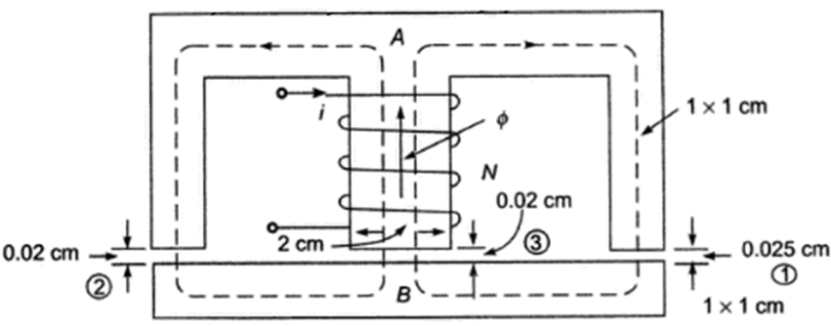
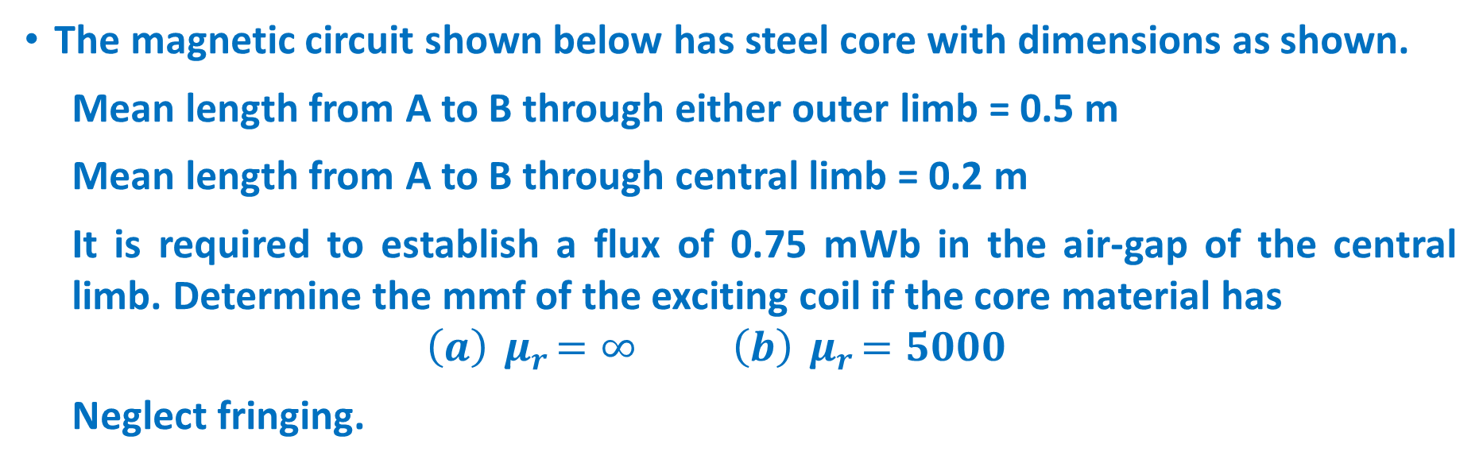
The magnetic circuit shown below has steel core with dimensions as shown.
Mean length from A to B through either outer limb = 0.5 m
Mean length from A to B through central limb = 0.2 m
It is required to establish a flux of 0.75 mWb in the air-gap of the central limb. Determine the mmf of the exciting coil if the core material has
$$\left(a\right){ μ}_{r}=∞ \left(b\right){ μ}_{r}=5000$$
Neglect fringing.

Slide 14
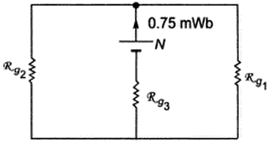


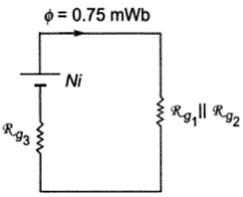

$$\left(a\right){ μ}_{r}=∞$$

Slide 15


$$\left(a\right){ μ}_{r}=∞$$

Slide 16
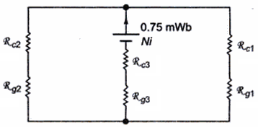





$$\left(b\right){ μ}_{r}=5000$$

Slide 17



Direction of Current in a Conductor
No current through the conductor.
Conductor carries current away from the page.
Conductor carries current towards the page.

Slide 18
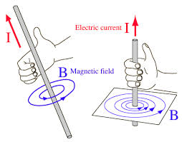
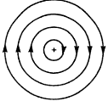
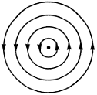
Right Hand Rule
The direction of magnetic flux is found by using right hand rule.
Rule says that if one holds the conductor in such a way that the thumb points in the direction of current, then the closed fingers give the direction of flux produced.

Slide 19
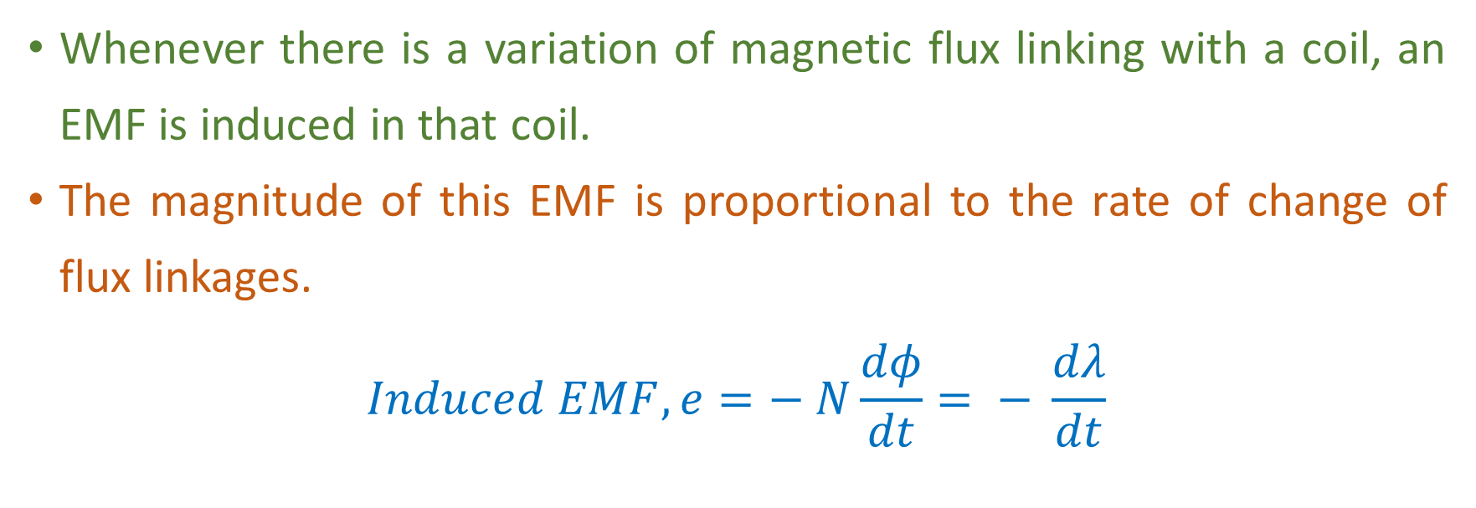
Faradays Law
Whenever there is a variation of magnetic flux linking with a coil, an EMF is induced in that coil.
The magnitude of this EMF is proportional to the rate of change of flux linkages.
$$Induced EMF, e=− N\frac{dφ}{dt}= − \frac{dλ}{dt}$$

Slide 20
Lenz’s Law
Lenz’s law states that the induced EMF in a coil will induce a current whose direction is such that it opposes the cause producing the EMF.

Slide 21
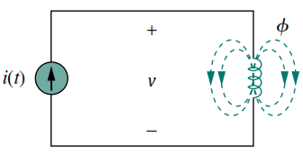




Self Inductance
Consider a coil with N turns.
When current i flows through it, a flux ɸ will be produced.
As per Faraday’s law,
Flux ɸ is produced by current i and hence any change in ɸ is caused by changes in i. Therefore,
The inductance L of the inductor is,
This is called the Self Inductance of the coil.

Slide 22
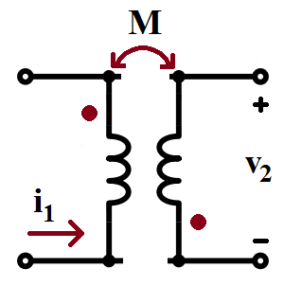
Mutual Inductance
Mutual inductance is the ability of one inductor to induce a voltage across a neighboring inductor.
It is measured in henrys (H).
The polarity of mutual voltage is determined by using dot covention.
A dot is placed at one end of each coupled coils to indicate the direction of the magnetic ﬂux if current enters that dotted terminal of the coil.

Slide 23
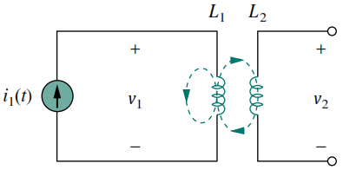

Mutual Inductance
Consider 2 coils with self inductances L₁ & L₂ are kept close together.
Coil 1 has N₁ turns and coil 2 has N₂ turns.
Current i₁ creates a flux ɸ₁ in coil 1.
This flux has got 2 components.
ɸ₁ ₁ links with coil 1 only.
ɸ₁ ₂ links with both the coils.
Although both coils are physically separated, they are magnetically coupled.

Slide 24
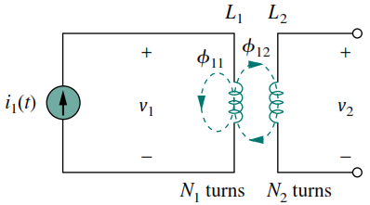








Mutual Inductance
Voltage induced in coil 1 is,
L₁ is the self inductance of the coil.
Voltage induced in coil 2 is,
M is the mutual inductance between the 2 coils.

Slide 25
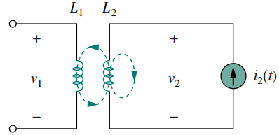

Mutual Inductance
Now consider a current i₂ flows through coil 2 and produces a flux ɸ_{2.}
This flux has got 2 components.
ɸ₂₂ links with coil 1 only.
ɸ ₂₁ links with both the coils.

Slide 26
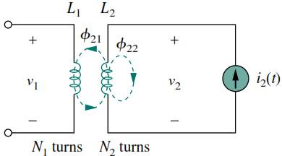








Mutual Inductance
Voltage induced in coil 2 is,
L₂ is the self inductance of the coil.
Voltage induced in coil 1 is,
M is the mutual inductance between the 2 coils.

Slide 27
Types of Induced EMF
According to Faraday’s law of electromagnetic induction, an EMF is induced by changing the flux linkages in a coil. It can happen in two ways.
EMF is induced either “moving the coil and keeping the magnetic field stationary” or “moving the magnetic field and keeping the coil stationary”.
EMF is induced by changing the flux linking with a coil without moving either coil or magnetic field system.

Slide 28
Dynamically Induced EMF
“Moving the coil and keeping the magnetic field stationary” or “moving the magnetic field and keeping the coil stationary”.
EMF induced by this way is called dynamically induced emf.

Slide 29
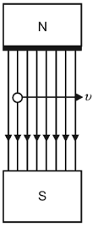
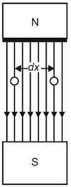
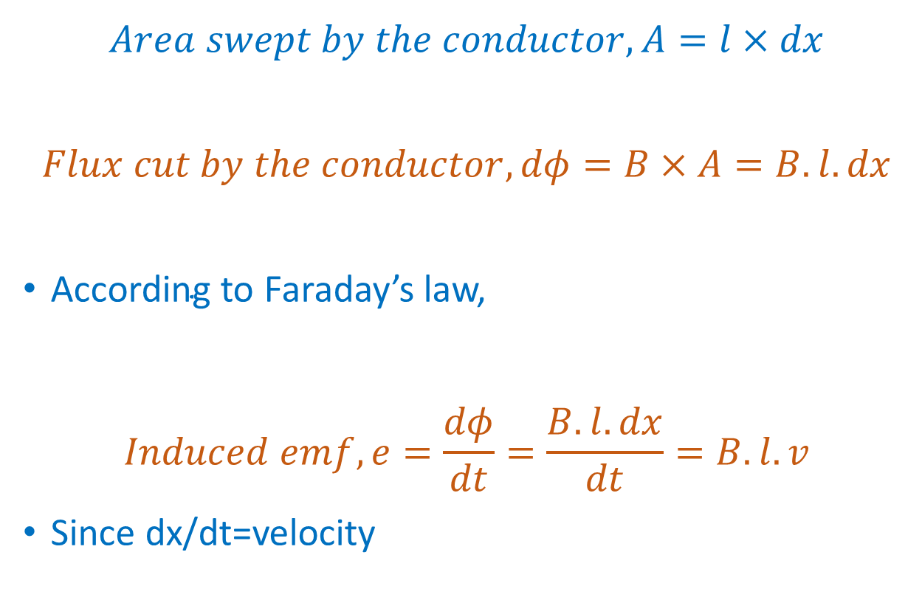
Dynamically Induced EMF
$$Area swept by the conductor, A=l×dx$$
$$Flux cut by the conductor, dφ=B×A=B.l.dx$$
$\text{According} \text{to} \text{Faraday}\text{’}\text{s} \text{law}\text{,}$
$$Induced emf, e=\frac{dφ}{dt}=\frac{B.l.dx}{dt}=B.l.v$$
Since dx/dt=velocity

Slide 30
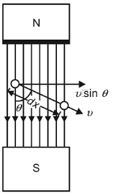
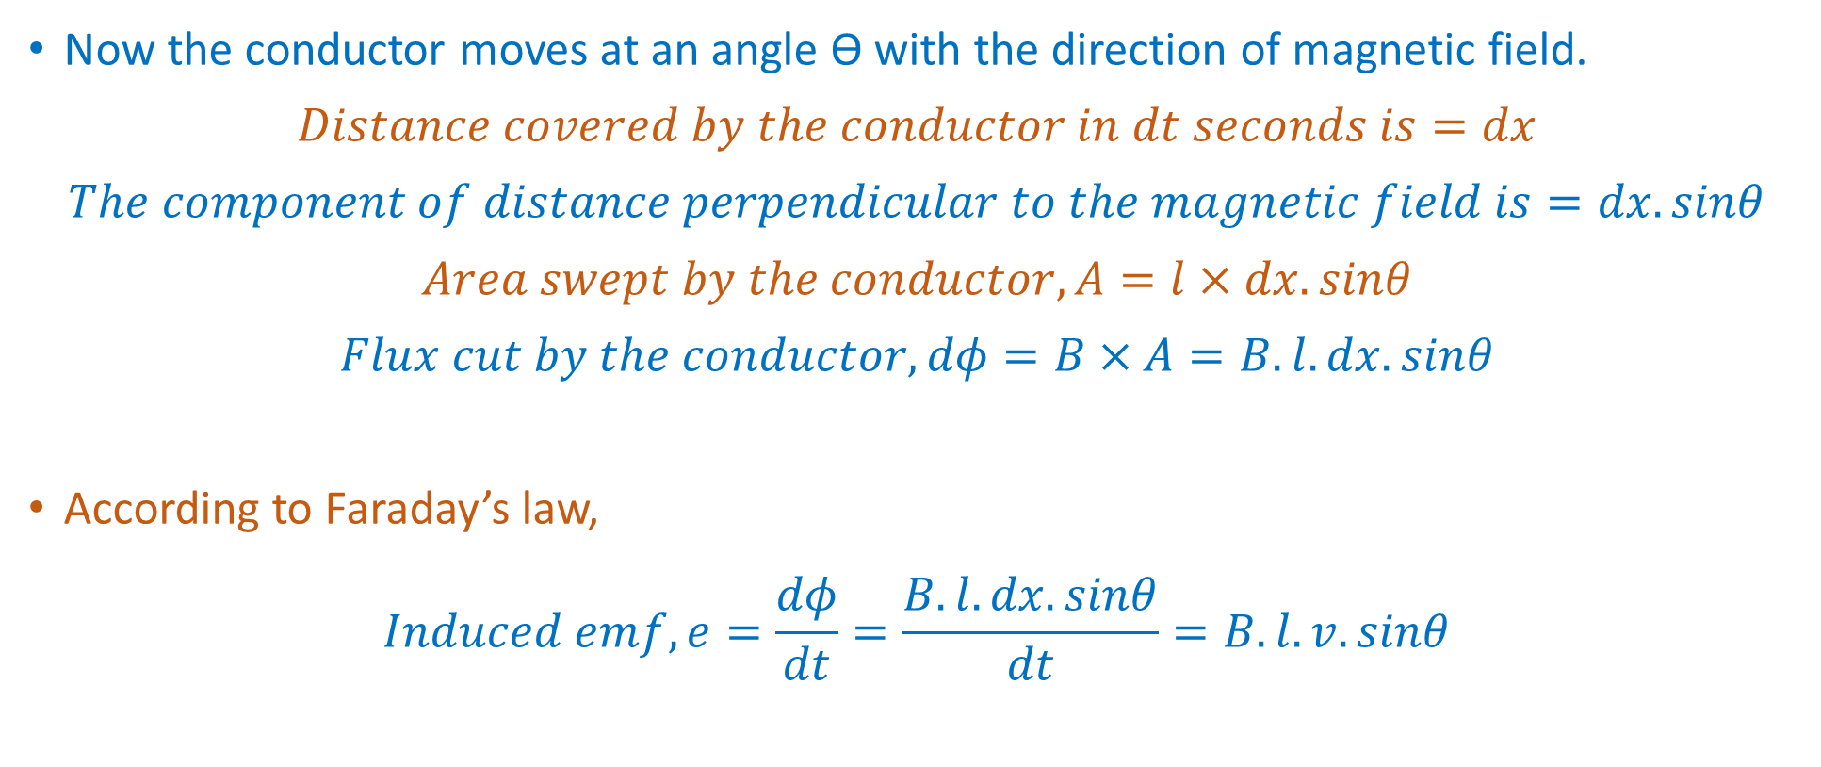
Dynamically Induced EMF
Now the conductor moves at an angle ϴ with the direction of magnetic field.
$$Distance covered by the conductor in dt seconds is=dx$$
$$The component of distance perpendicular to the magnetic field is=dx. sinθ$$
$$Area swept by the conductor, A=l×dx.sinθ$$
$$Flux cut by the conductor, dφ=B×A=B.l.dx.sinθ$$
$\text{According} \text{to} \text{Faraday}\text{’}\text{s} \text{law}\text{,}$
$$Induced emf, e=\frac{dφ}{dt}=\frac{B.l.dx.sinθ}{dt}=B.l.v.sinθ$$

Slide 31
Statically Induced EMF
EMF induced in a coil when both the coil and magnetic field system are stationary but the magnetic flux linking with the coil changes is called statically induced emf.

Slide 32
Types of Statically Induced EMF
Self – Induced e.m.f.
Mutually Induced e.m.f.

Slide 33
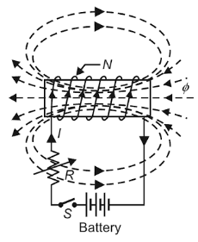
Self Induced EMF
Self-induced e.m.f. is the e.m.f. induced in a coil due to its own changing flux linked with it.

Slide 34
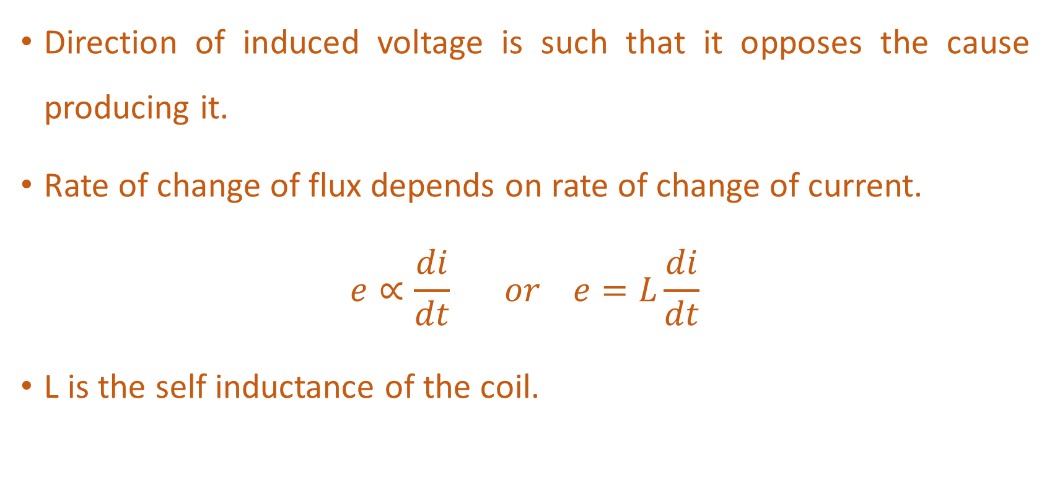
Self Induced EMF
Direction of induced voltage is such that it opposes the cause producing it.
Rate of change of flux depends on rate of change of current.
$$e∝\frac{di}{dt} or e=L\frac{di}{dt}$$
L is the self inductance of the coil.

Slide 35
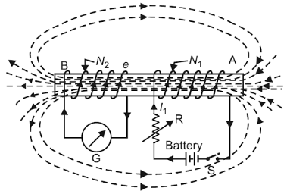
Mutually Induced EMF
Mutually induced e.m.f. is the e.m.f. induced in a coil due to the change of flux produced by another coil (kept close) linking with it.

Slide 36
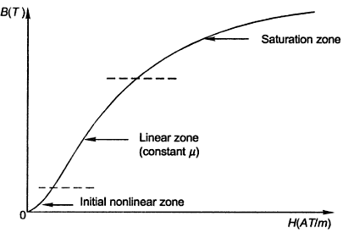
Magnetisation Curve
The curve that shows the variation in magnetic flux density B with respect to the variation in magnetic field intensity H in a ferromagnetic material.

Slide 37
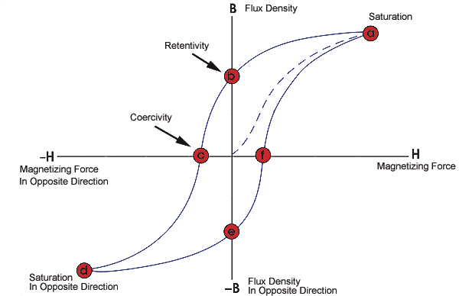
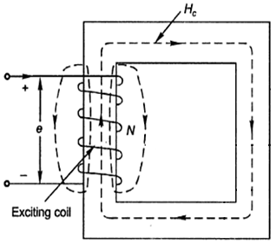
Hysteresis Loop
A hysteresis loop shows the variation of the magnetic flux density (B) with respect to the variation in magnetizing force (H).
It is often referred to as the B-H loop.

Slide 38
Hysteresis Loop
Retentivity – It is the ability of a material to retain a certain amount of residual magnetic field when the magnetizing force is removed after achieving saturation.
Residual Magnetism or Residual Flux – The magnetic flux density that remains in a material when the magnetizing force is zero.
Coercive Force – The amount of reverse magnetic field which must be applied to a magnetic material to make the magnetic flux return to zero.

Slide 39
Hysteresis and Eddy Current Loss
When a magnetic material is subjected to cyclic magnetization, two kinds of power losses occur in it.
Hysteresis loss and Eddy current loss together called core loss.

Slide 40
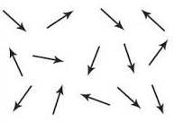
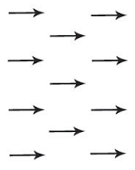
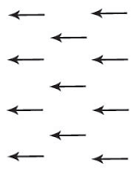
Hysteresis Loss
Magnetic circuit is subjected to magnetic field reversals as it passes under successive poles.

Slide 41
Hysteresis Loss
Some amount of power has to be spent to reverse the molecular magnets in the armature core continuously.
It is considered as loss.
The loss of power in the core due to hysteresis effect is called hysteresis loss.

Slide 42
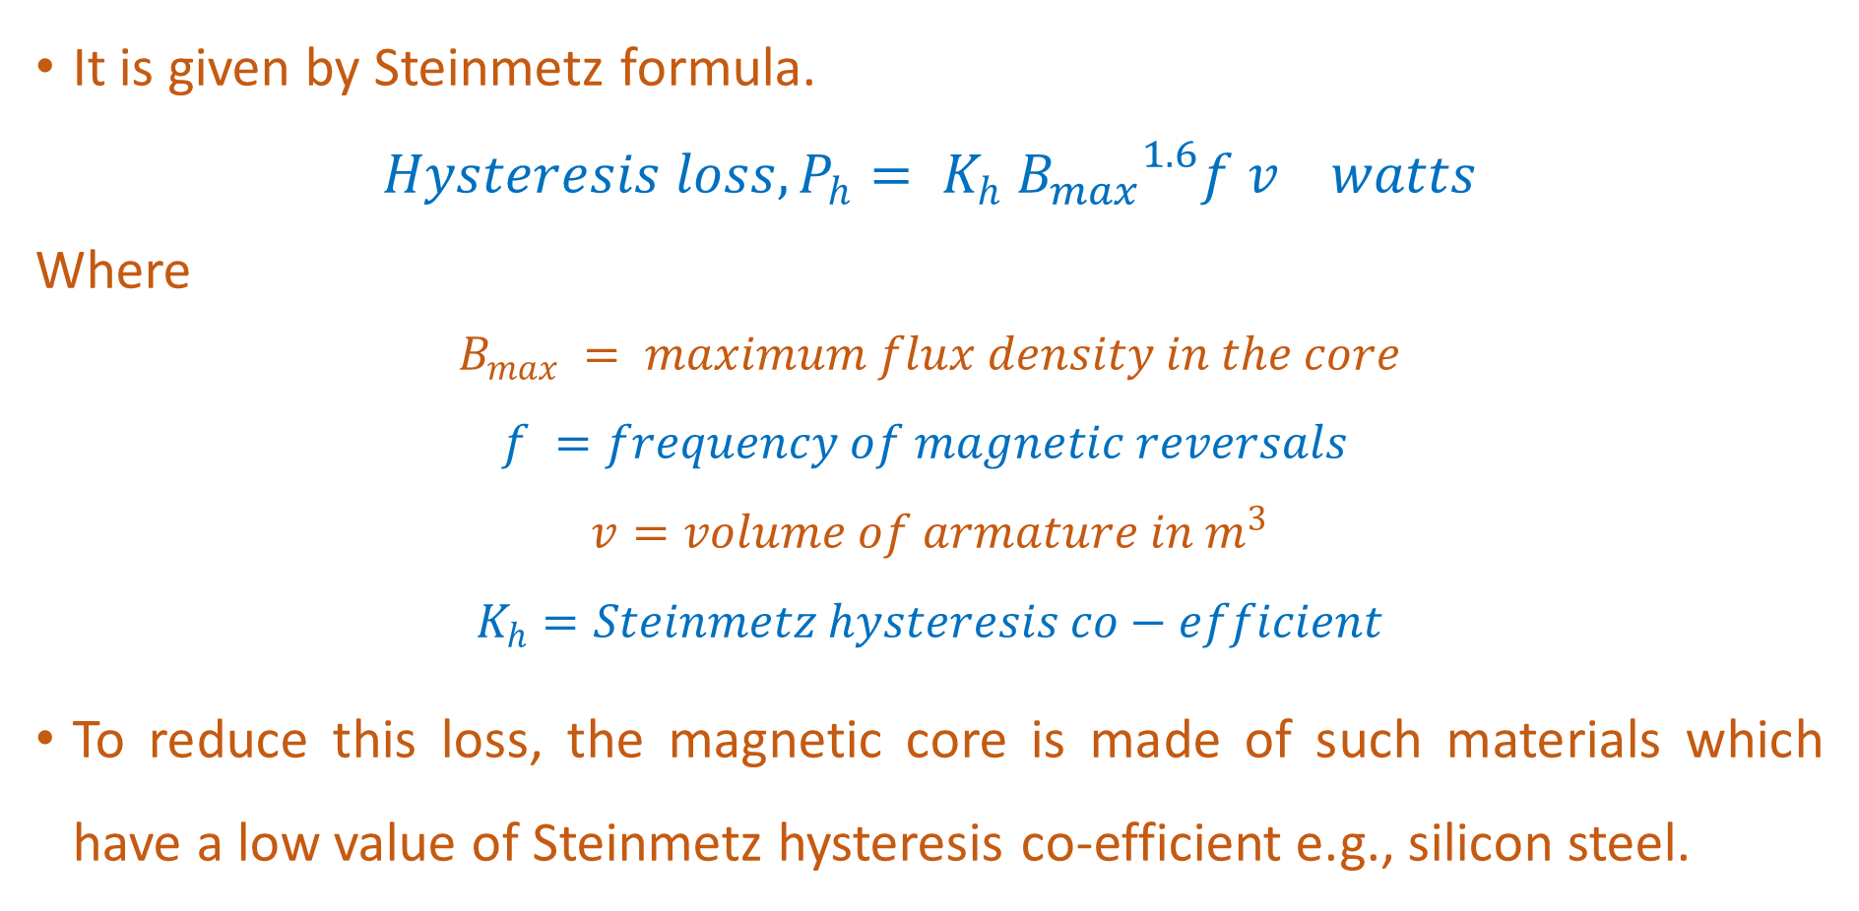
Hysteresis Loss
It is given by Steinmetz formula.
$$Hysteresis loss, P_{h}= K_{h} {B_{max}}^{1.6}f v watts$$
Where
$$B_{max} = maximum flux density in the core$$
$$f =frequency of magnetic reversals$$
$$v=volume of armature in m^{3}$$
$$K_{h}=Steinmetz hysteresis co−efficient$$
To reduce this loss, the magnetic core is made of such materials which have a low value of Steinmetz hysteresis co-efficient e.g., silicon steel.

Slide 43
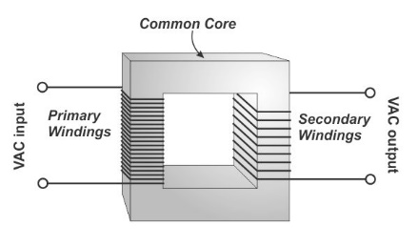
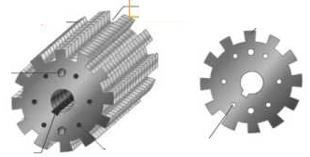
Eddy Current Loss
In addition to the voltages induced in the conductors, there are also voltages induced in the magnetic core.
These voltages produce circulating currents in the core.

Slide 44
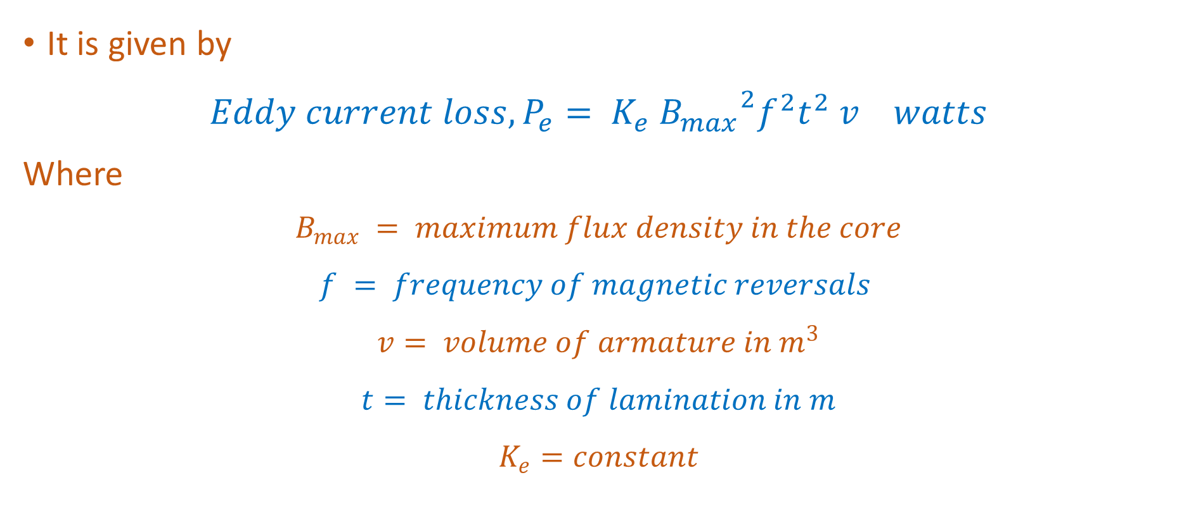
Eddy Current Loss
It is given by
$$Eddy current loss, P_{e}= K_{e} {B_{max}}^{2}f^{2}t^{2} v watts$$
Where
$$B_{max} = maximum flux density in the core$$
$$f = frequency of magnetic reversals$$
$$v= volume of armature in m^{3}$$
$$t= thickness of lamination in m$$
$$K_{e}=constant$$

Slide 45
The core loss (hysteresis + eddy current loss) for a given specimen of magnetic material is found to be 2000 W at 50 Hz. Keeping the flux density constant, the frequency of the supply is raised to 75 Hz resulting in a core loss of 3200 W. Compute separately hysteresis and eddy current losses at both the frequencies.

Slide 46
Leakage Flux
The stray flux, which does not take part in the energy conversion process, is called leakage flux.
This leakage flux can never be eliminated.
The effect of leakage flux is incorporated in machine models through the concept of the leakage inductance.

Slide 47
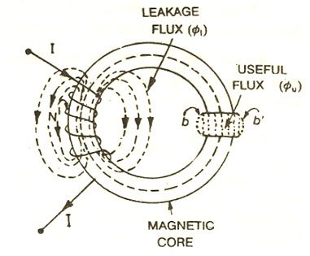
Fringing
The flux in a magnetic circuit bulges (or fringes) outwards while passing through an air-gap.
This results in non-uniform flux density in the air-gap, enlargement of air-gap area and reduction in flux density in air-gap.
This phenomenon is called fringing. The effect of fringing increases with the increase in air-gap length.

Slide 48
Stacking Factor
Magnetic cores are made up of thin, lightly insulated (coated with varnish) laminations to reduce eddy current loss.
As a result, the net cross sectional area of the core occupied by the magnetic material is less than its gross cross section.
Hence the ratio of net cross sectional area to the gross cross sectional area of the core is called Stacking factor.

Slide 49

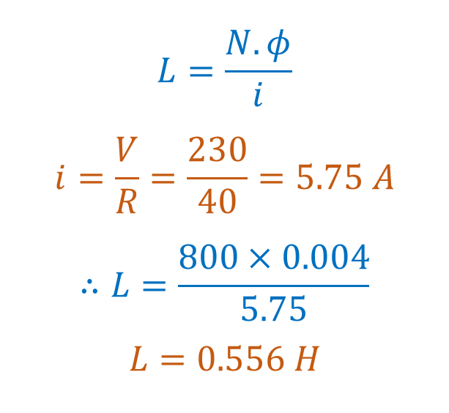
The field winding of DC electromagnet is wound with 800 turns and has a resistance of 40Ω when exciting voltage is 230 V and the magnetic flux around the coil is 0.004 Wb. Calculate self-inductance and energy stored in magnetic field.
$$L=\frac{N.φ}{i}$$
$$i=\frac{V}{R}=\frac{230}{40}=5.75 A$$
$$∴L=\frac{800×0.004}{5.75}$$
$$L=0.556 H$$
$$Energy Stored in magnetic field, e=\frac{1}{2}Li^{2}$$
$$e=\frac{1}{2}0.556×{5.75}^{2}$$
$$e=9.19 Joules$$

Slide 50


Two coils A and B are wound on same iron core. There are 600 turns on A and 3600 turns on B. 4 amps of current through the coil A produces a flux of 500 X 10⁻⁶ Wb in the core. If this current is reversed in 0.02 seconds, calculate average emf induced in coils A and B.
Current reversal means that the current changing from +4A to -4A.
Actual change in current is 8A. Hence change in flux is 1000 X 10⁻⁶ wb
$$EMF in coil A=N_{1}.\frac{dφ}{dt}$$
$$EMF in coil A=600.\frac{0.001}{0.02}$$
$$E=30 V$$
$$EMF in coil B=N_{2}.\frac{dφ}{dt}$$
$$EMF in coil B=3600.\frac{0.001}{0.02}$$
$$E=180 V$$

Slide 51
Properties of Magnetic Materials
All materials are classified according to their relative permeability.
Paramagnetic
µ_{r} slightly greater than 1
Diamagnetic
µ_{r} slightly lesser than 1
Ferro & Ferrimagnetic
µ_{r} much higher than that of free space

Slide 52

Properties of Magnetic Materials
Ferromagnetic materials are further subdivided into hard and soft.
Hard
(Per. Magnet)
Alnico
Chromium steel
Soft
Iron and its alloys with nickel, cobalt, tungsten and aluminium
Copper nickel alloys
Metal alloys

